Slide 1
ONLINE VOTING SYSTEM
Presented by
Group 11
gangsta: adwin , farzin , sibix

Slide 2
AGENADA
OBJECTIVES
INTRODUCTION
ADVANTAGES OF PROJECT
FLOW CHART
ALGORITHM
OUTPUTS
CONCLUSION

Slide 3
OBJECTIVE
Maintaining voter’s Identification.
Providing online voting management.
Providing updation of voter’s information.
Provide voter information to COLLEGE ELECTION COMMISION.
COLLEGE ELECTION COMMISION maintains the complete information of voter.
Voter can give his\her vote from any part of India.

Slide 4
INTRODUCTION
The election voting system based on concept of casting the vote for the candidates.
The system allows the user or voters to cast their votes after choosing, the system displays 3 options
1'cast the vote
2*find vote count
3*find leading candidate
In 1st option the system shows the name of candidates for the voter to caste the vote. After the voting the screen will refresh.
The board members who conduct the election can only access the other 2 options with a passcode that we set.
By the 2nd option we can known how much vote did each candidate get.
In 3rd option we can know the leading candidate.
In the program we use #define, switch, break, if-else, do-while.

Slide 5
ADVANTAGE OF PROJECT
SECURE VOTING
MORE TIME EFFICIENT
REDUCE THE PAPER WORKS
ACCURATE
COST EFFECTIVE
100% GREEN FRIENDLY

Slide 6
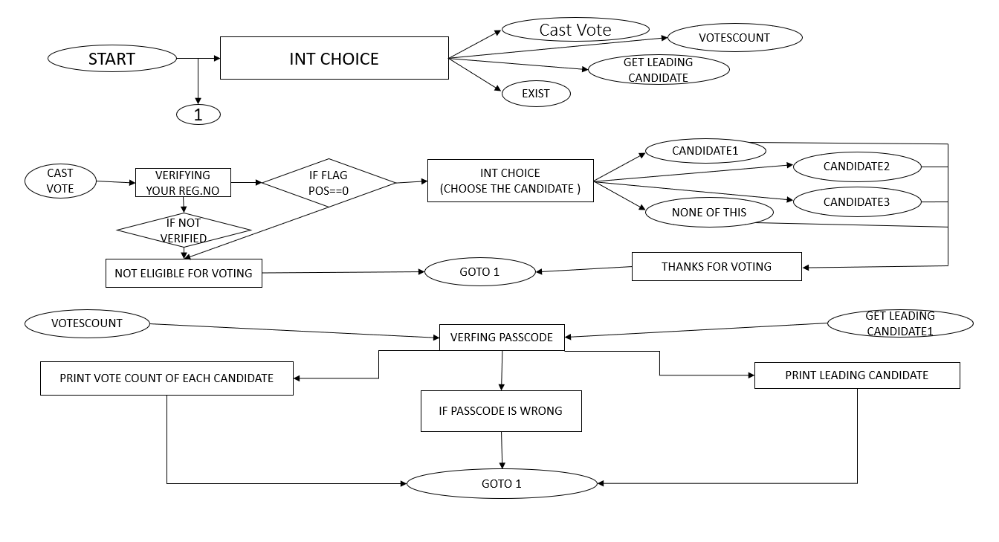
FLOW CHART

Slide 7
ALGORITHM
Step 1 : Start
Step 2 : Set flag []==0
Step 3 : print
1-caste the vote
2- find vote count
3- find leading candidate
Step 4 : read choice
Step 5 : if choice ==1, enter registration number and assign to reg

Slide 8
Step 5:1 : if condition is true (strcmp(a[i],reg)==1) , then
Step 5:2:if fix flag[pos]==0 ,print list of candidates.
Step 5:2:1 : read the choice and add to the votecount
Step 5:2:2 :else print “you are already done”
Step 5:3: change flag[pos]==1 for the corresponding reg.no
Step:5:4: print thanks for vote
Step 5:5 :refresh the screen
Step 6 : Else choice==2,Then print “enter the passcode”
Step 7 : if the passcode is correct ,print the votecount of each candidate and spoiled votes
Step 7:1 :else print wrong passcode
Step 7:2 :refresh the screen
Step 8 :else choice==3,then print “enter the passcode “
Step 9 :if the passcode is correct , print the leading candidate
Step 9:1 :else print “wrong passcode”
Step 9:2:refresh the screen
Step 10 :else exit .

Slide 9
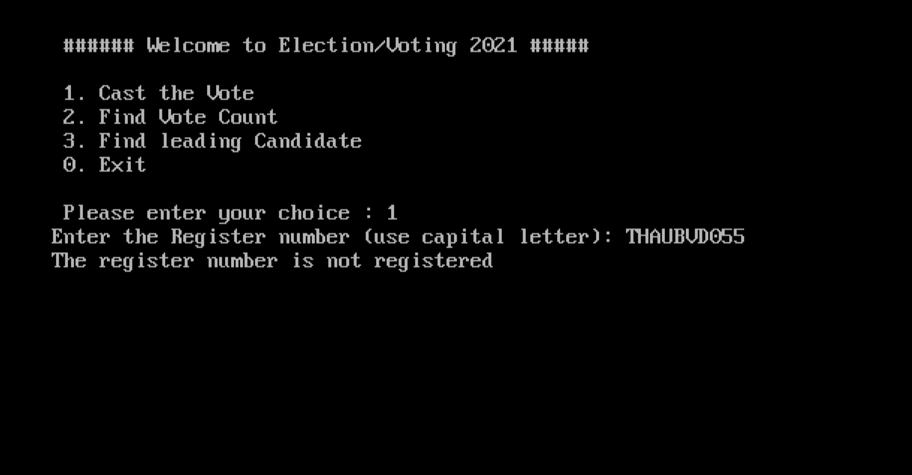
OUTPUT 1)TO CAST THE VOTE
i. If the entered register number is WRONG:-

Slide 10
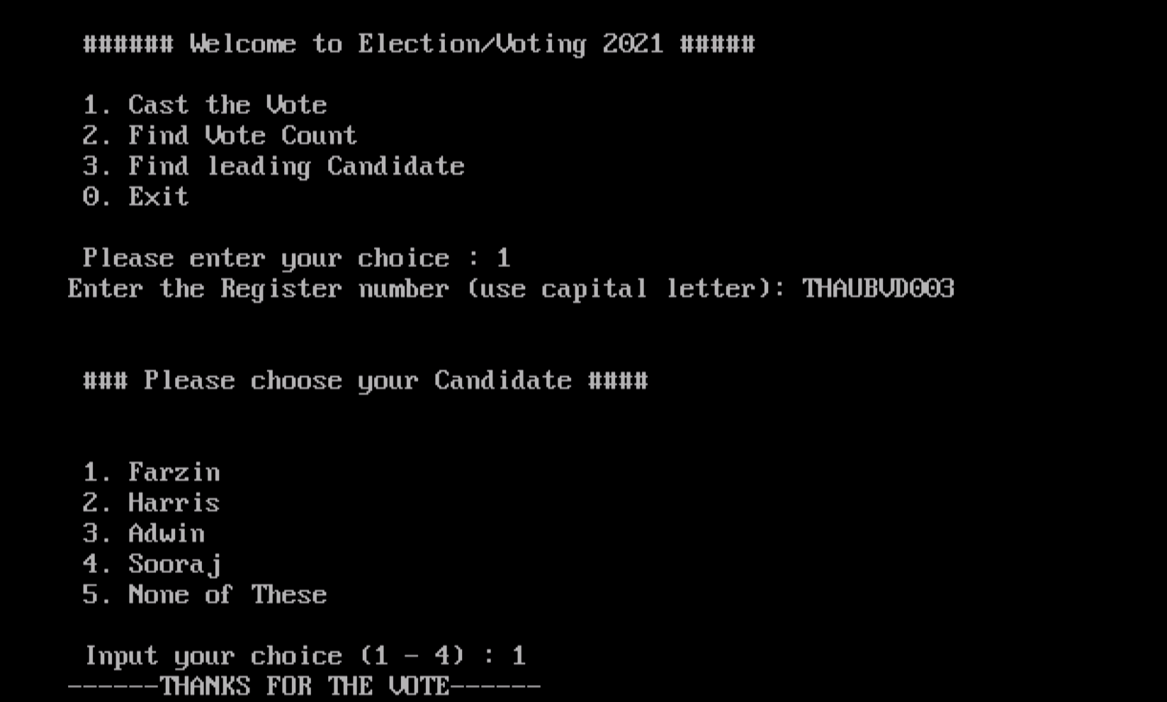
ii. If entered register number is CORRECT:-

Slide 11
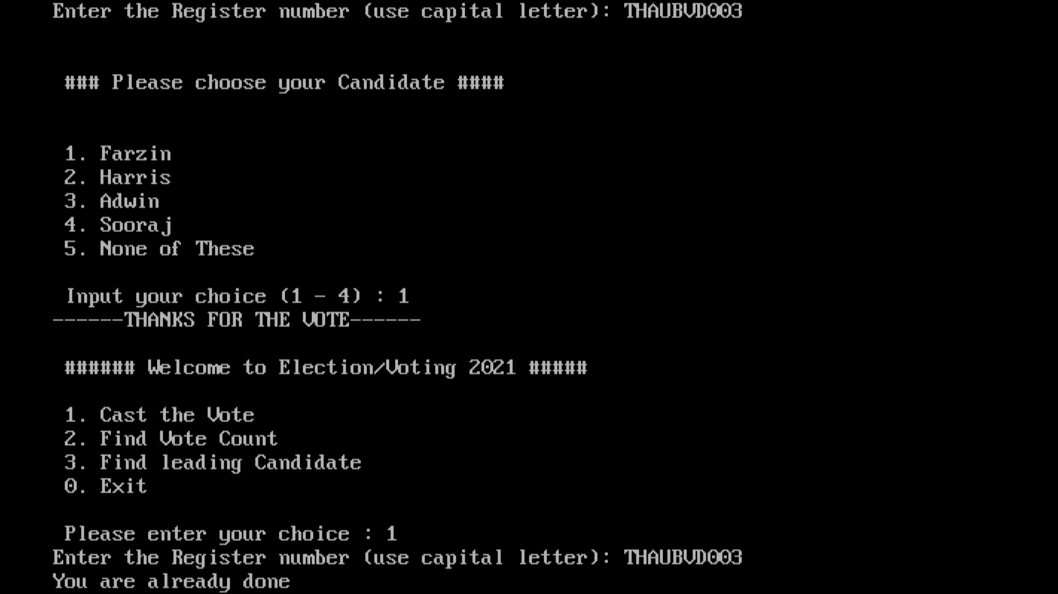
2)If the register number is already voted:-

Slide 12
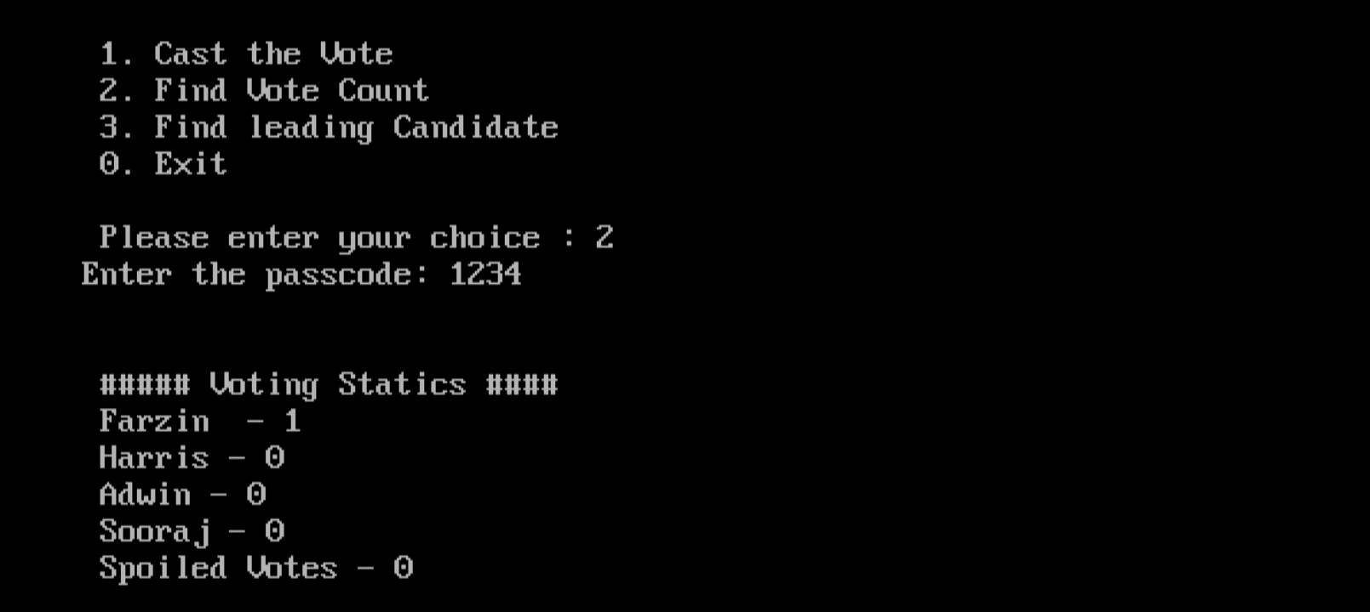
3)To find the vote (only for responsible authority):-

Slide 13
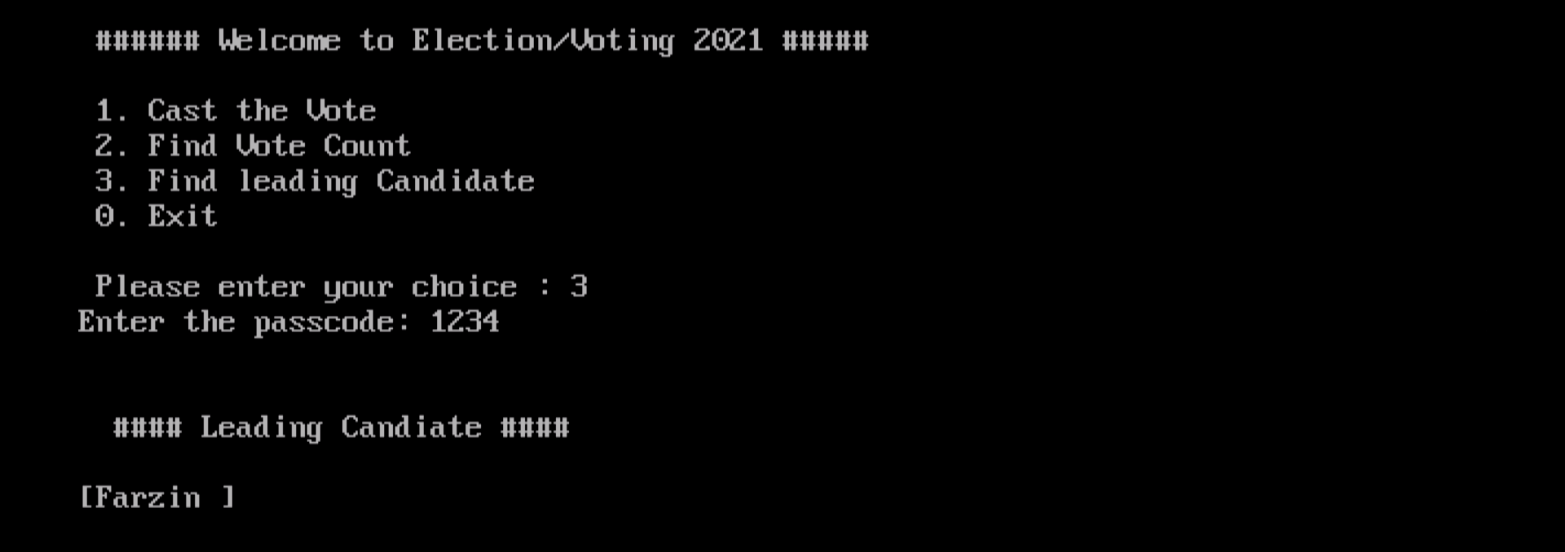
4)To find the leading candidate(only for responsible authority):-

Slide 14
CONCLUSION
By doing this project we were able to bring a new voting system. With the advent of technology and Internet in our day to day life, we were able to offer advanced voting system to voters in our college both from the native district and outside through our Online voting system.
Efficient and Cost Effective.
Intelligent.
Save Time and Resources.
Easy and convenient.
Efficient data storage.
Accuracy, real-time response and user friendliness.
Intelligent Management

